Slide 1

Hatch Warren Junior School
Welcome!
Runway’s End residential information evening
12th January to 16th January 2026

Slide 2


Slide 3


Slide 4
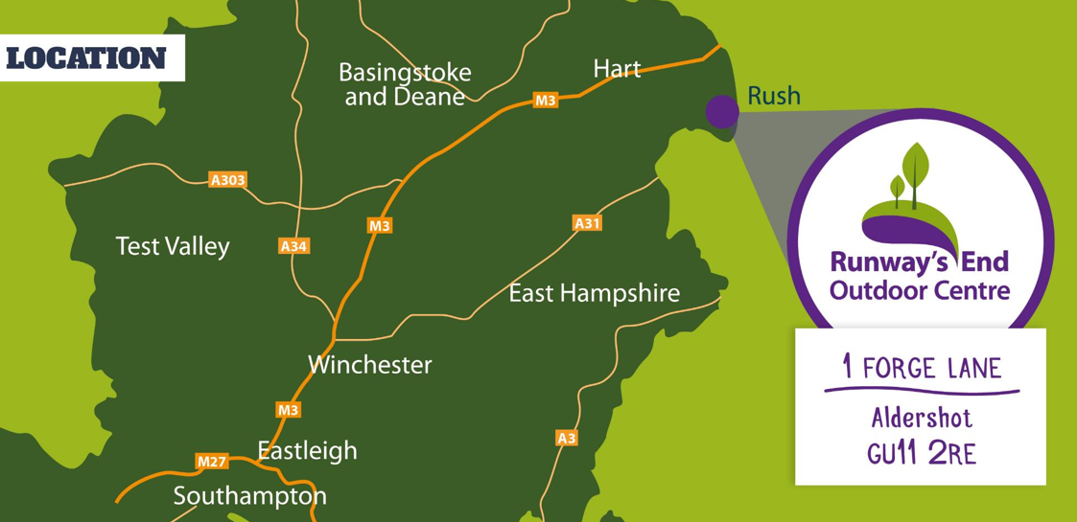

Slide 5
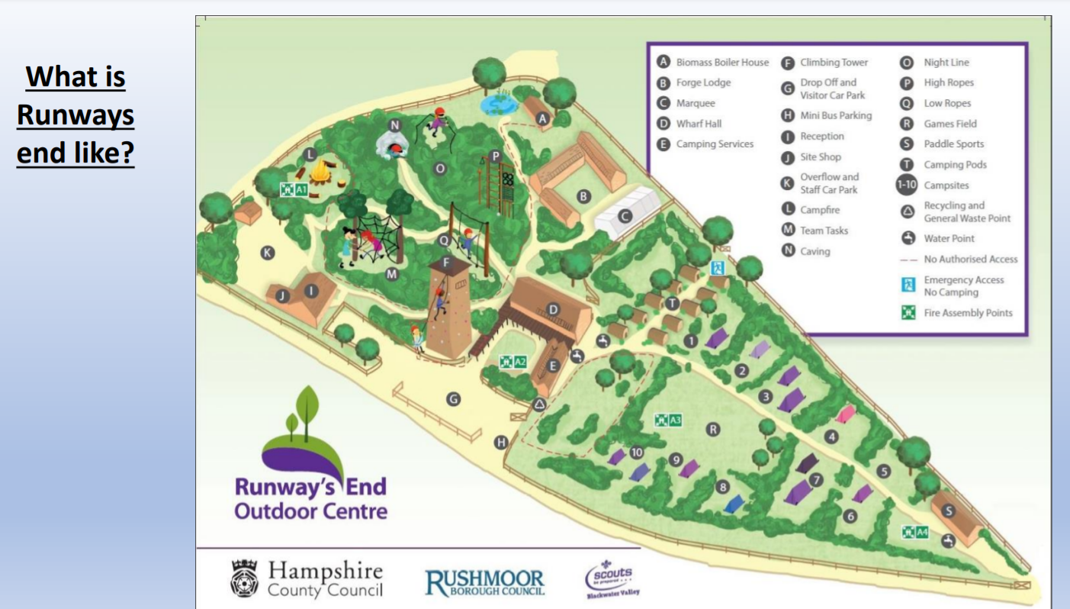
What does the Runway’s End site look like?

Slide 6
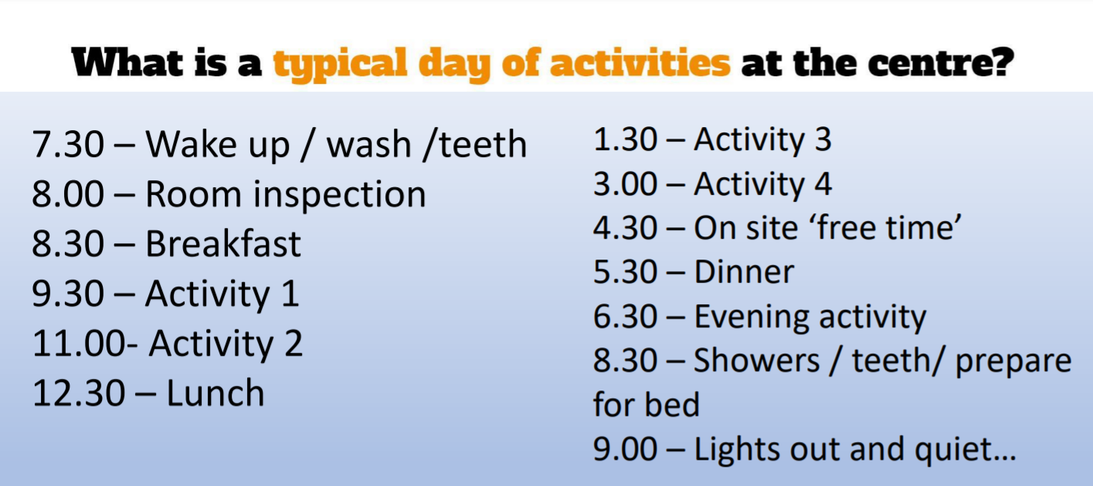
Evening activities will be run by HWJS staff.
These are likely to be a quiz, movie night, games night and an outdoor activity.
These are subject to change and weather dependant.

Slide 7



Slide 8


Slide 9
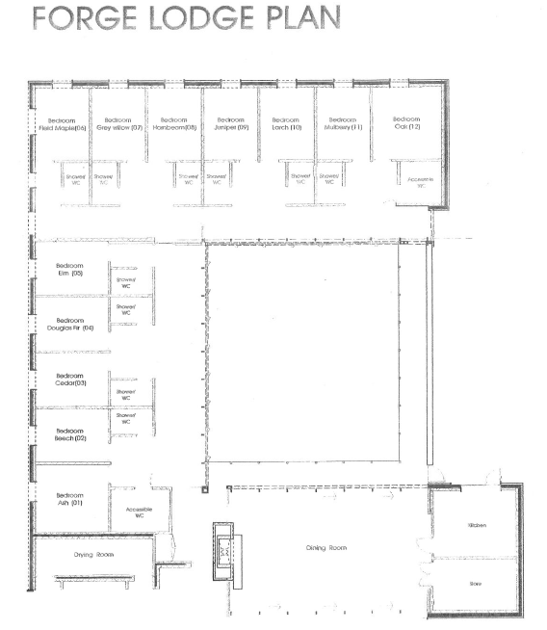
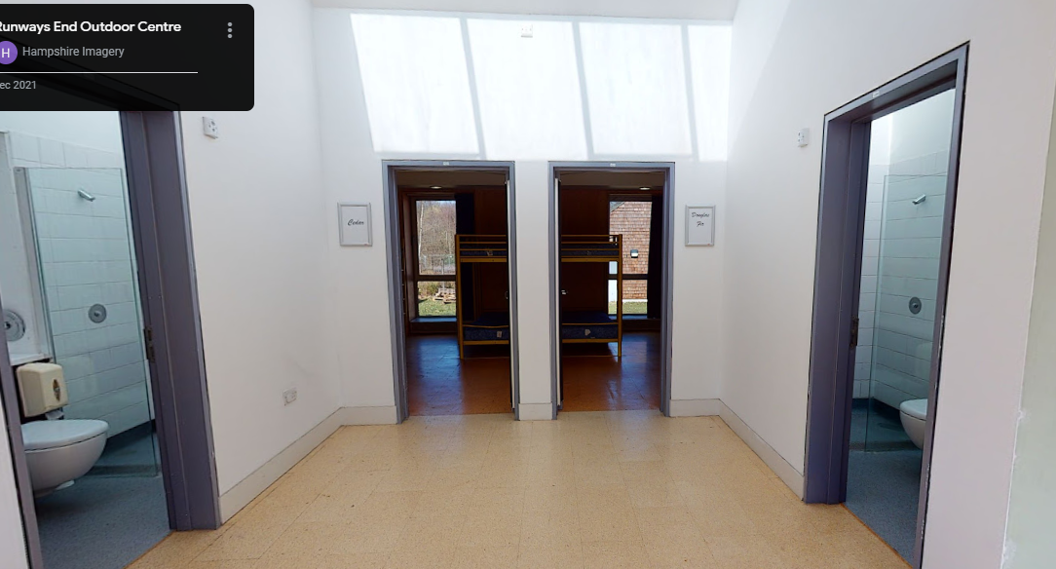
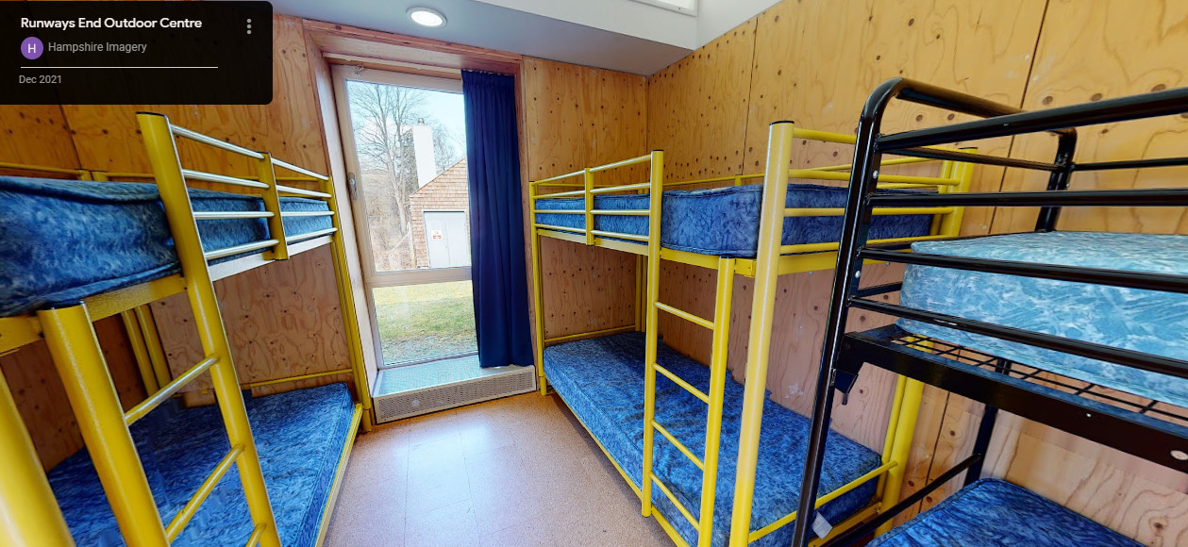

Slide 10
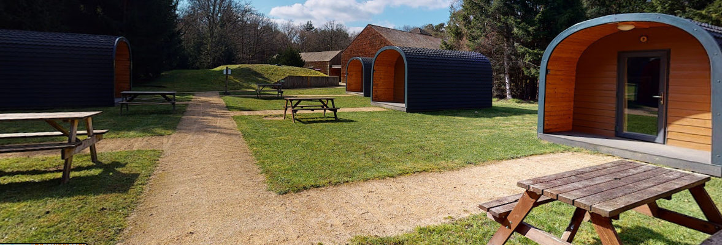
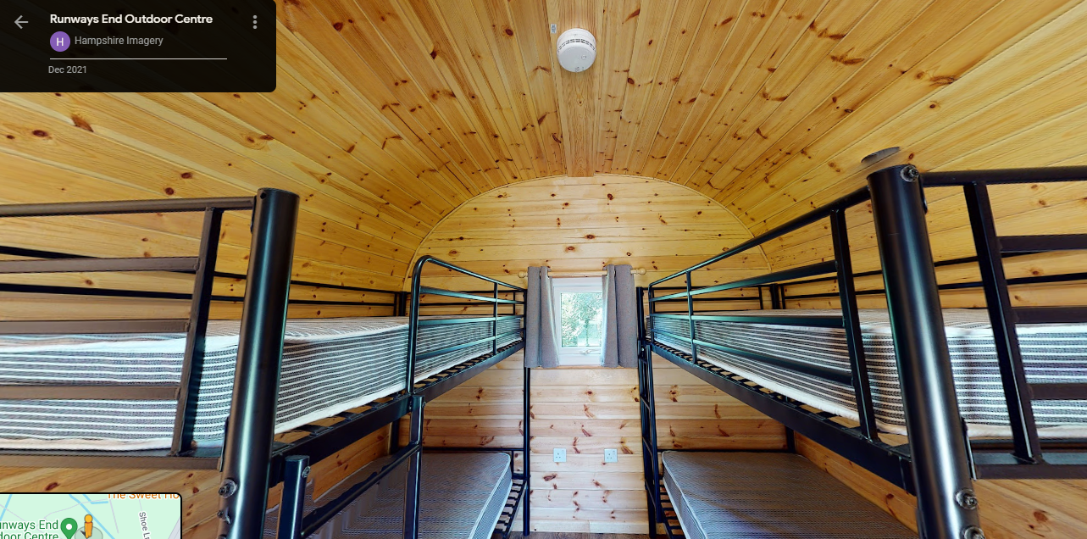

Slide 11

This is a sample menu from Runway’s End. The menus are subject to change.

Slide 12
Kit and other items:
Kit – please look closely at the kit list. All items need to be named. They must have a waterproof coat, warm clothes and appropriate footwear (old trainers for activities, indoor shoes/slippers plus a different pair of old shoes/water shoes for water activities). Ideally kit should be in a soft bag due to space in the room – hard suitcases will not fit under the beds and there is no space to store them in the rooms. Please remember wash kit and towels.
Packed lunch - the children WILL need a packed lunch for the first day. Please can we ask that this is in a bag rather than a lunch box (so the lunch boxes don’t fester away all week!).
Water bottle – a NAMED refillable bottle for the week.
Small activity day bag – so that the children can store coats, water bottles etc during the activities. Their lunch can be in this bag for the first day.
Bedding – children MUST bring bedding (sleeping bag, pillow & single sheet). Please make sure the bedding bag is named!
Book – the children will need a book to read in bed before lights out.
Torch – very important for evening activities outside
Teddy!

Slide 13
What my child will NOT need
NO mobile phone
NO money – there is nowhere to spend money while they are on-site
NO electronic items – except a torch. This will be useful in the evenings for some evening activities.
Snacks, sweets or food of any kind other than the packed lunched on Monday. Please be considerate of this as we have children with allergies.

Slide 14
Drop off and pick up arrangements
Children can bring bags into their classes from 8.45am. The children will then remain in class to be registered.
Please ensure children are on time and arrive with everything they will need, including a packed lunch. They need to be dressed ready for outdoor activities.
All medicines will need to be given to Mrs Knoll in the morning. There will be a table set up outside the Main office. Please make sure medicines are very clearly labelled.
The coach will leave at 10am to arrive for a welcome briefing at the centre mid morning. You are welcome to wave the children off, however for safety reasons, you must be outside the carpark barrier. The first activity will be after their packed lunch.
Pick up: We aim to be back at school around 2:45pm on Friday 16th January. As always, the office will update you via text if there are any changes to our return journey. Children will be taken to the hall and you will collect them, their bags and any medicines from there. The children need to be checked out, so please be patient as this takes time. Siblings can also be collected.

Slide 15
What else do I need to know…
Medical and dietary requirement form (sent on TPT) to be completed by Monday 1st December.
This is so we can confirm meal requirements with the centre
The deadline for final payments was 15th November. Please contact the office via email if you require assistance with settling the final payments.
If your child requires medication during the trip, a second form – ‘Consent to Administer’ – will be sent to you. This will need to be completed by Friday 12th December, in order for any prescription medication to be given to children by staff.

Slide 16
Extra information and reminders:
If you would like any extra information about the centre, please visit https://www.hants.gov.uk/thingstodo/outdoorcentres/education/our-centres/runwaysend as they have a feature that allows you to tour the centre before you go! This is good to do with any children that may be worried about what the facilities look like.
The kit list will be sent home. Please refer to this to see what your child will need during their week away.
Bedding is required at this residential centre. All children will need to bring a pillow, sleeping bag and sheet with them to Runways End.
If you have any specific questions, please speak to your child’s class teacher or Mrs Taft.

