Slide 1
Welcome to our Year 3 Maths Café
2024

Slide 2

Welcome
Our aims:
To explain what maths looks like in our school
To give you an understanding of what happens in maths lessons
To explain what calculation methods are taught
To provide you with further information about how to support maths at home.

Slide 3

The 3 aims of the National Curriculum are to improve children’s mathematical skills in:
Fluency - the ability to recall and apply knowledge rapidly and accurately.
Reasoning - explain their mathematical thinking.
Problem solving - apply their knowledge to solve problems in varied contexts.

Slide 4
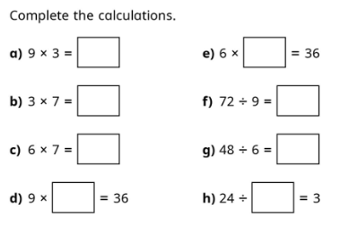
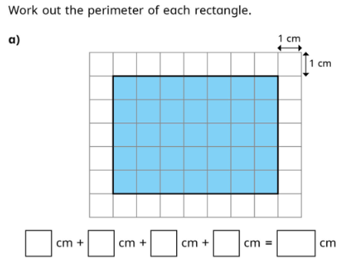
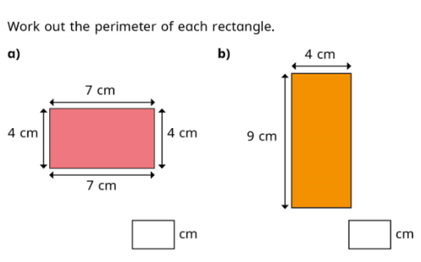
Examples of Fluency

Slide 5
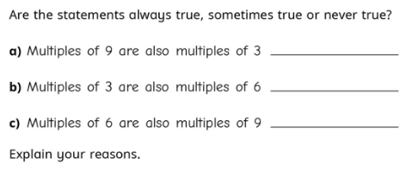
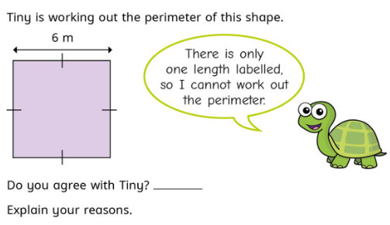
Examples of Reasoning

Slide 6
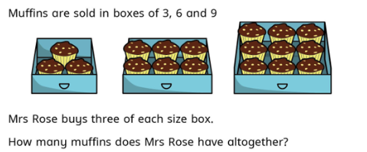

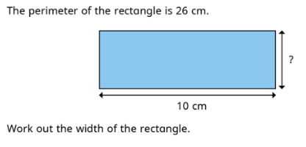
Examples of Problem solving

Slide 7

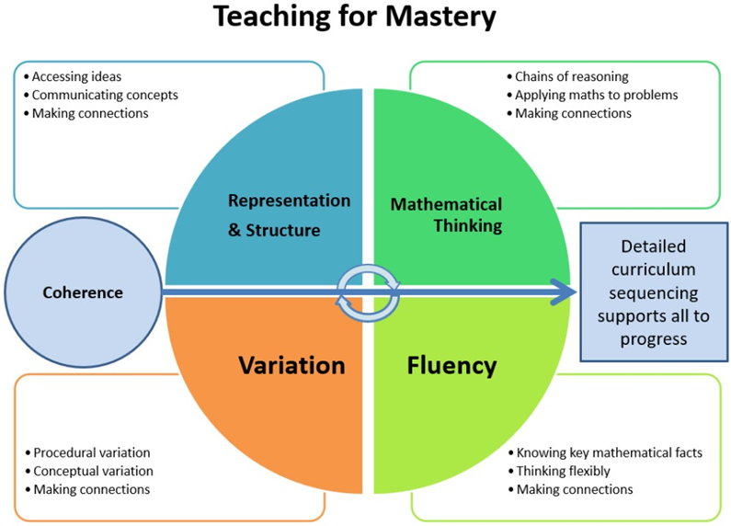
Maths at Hatch Warren Junior School
Since September 2023, we have moved away from ‘Wave’ maths teaching to a Mastery approach.

Slide 8
Key features of a mastery approach
The class work together on the same topic
The emphasis is on teaching to the whole class the same Year group objective. Support and challenge are provided through variation of the task, use of resources and questions from adults.
Focused, rigorous and thorough teaching
Within mastery, the idea is to develop one small step at a time in a lesson. The emphasis is on exploring the mathematical structure involved and the best way to represent them through models and images. Each small step builds towards a deeper understanding of a mathematical concept.

Slide 9
Key features of a mastery approach
More time on teaching topics – depth and practice
The same topic is likely to have the same focus until the class has mastered the concept, skill or procedure being taught. The learning points are taught over a longer time, with smaller steps of progression, and to allow for sufficient practice and depth to make learning effective.
Speedy teacher intervention to prevent gaps
Children that have not met the expected outcomes or have gaps in their mathematical understanding, will be helped by receiving short, immediate extra time on the maths. This is either before a lesson (pre-teach), during the lesson or later in the day. This is a positive opportunity to prepare for learning or to consolidate their understanding.

Slide 10
In maths lessons
We teach children new concepts through the ‘I do, We do and You do’ approach.
I do: In this phase, the teacher models how to complete a task or solve a problem. The teacher may use think-alouds, demonstrations, or other methods to show the children how to do the task.
We do: In this phase, the teacher and the children work together to complete the same task or solve the same problem. The teacher provides support and guidance as needed, but the children actively participate in the task.
You do: In this phase, the children work independently to complete a similar task or solve a similar problem. The teacher provides feedback and support as needed, but the children are responsible for completing the task independently.

Slide 11
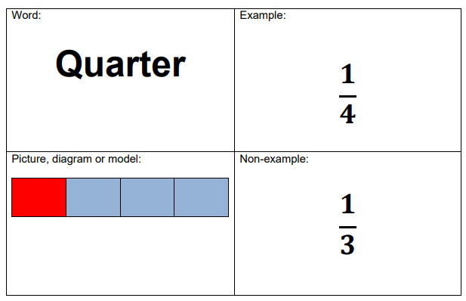
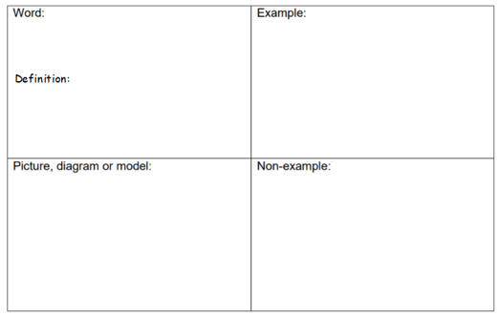
In maths lessons
We encourage the use of precise mathematical language as it gives children the language in order to express the maths and hang their learning on.
Frayer models are used for new vocabulary

Slide 12
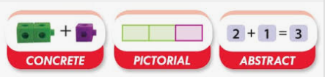
In maths lessons
We use a CPA approach to help children understand mathematical concepts.
Children manipulate hands-on concrete materials.
Children draw and use diagrams and representations of the hands-on materials.
Children record and observe the numbers and mathematical symbols.

Slide 13
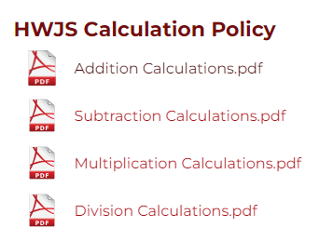
Calculation Strategies
Our Calculation policies for addition, subtraction, multiplication and division can be found on the school website.
Maths | Hatch Warren Junior School (hwjs.hants.sch.uk)

Slide 14
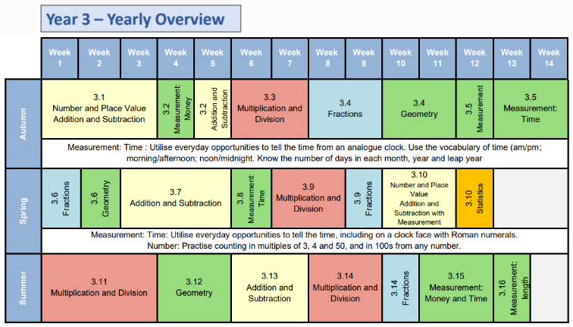

Slide 15
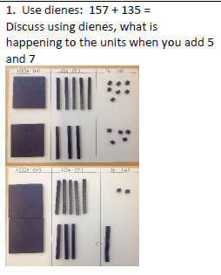
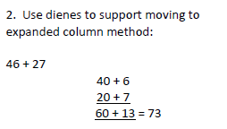
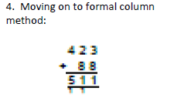
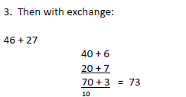
Year 3 Addition
End of year expectations
Add numbers with up to 3 digits using formal written methods of columnar addition.

Slide 16
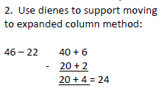
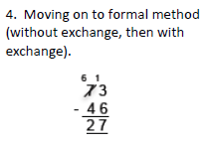
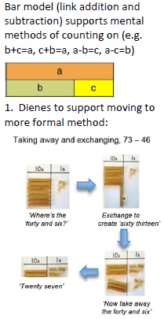
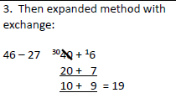
Year 3 Subtraction
End of year expectations
Subtract numbers with up to 3 digits using formal written methods of columnar subtraction.

Slide 17
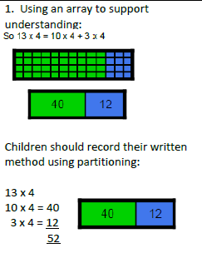
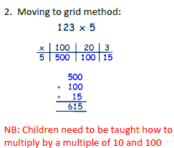
Year 3 Multiplication
End of year expectations
Write and calculate mathematical statements for multiplication using the multiplication tables they know, including for two-digit numbers times one-digit numbers, using mental and progressing to formal written methods.

Slide 18
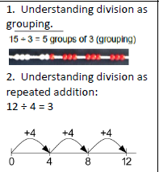
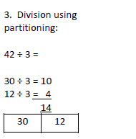
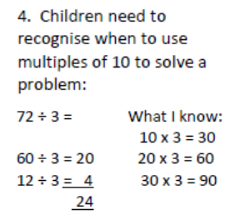
Year 3 Division
End of year expectations
Write and calculate mathematical statements for ÷ using the x tables they know progressing to formal written methods.

Slide 19
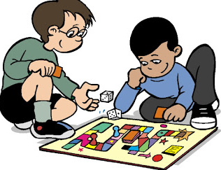
Helping At Home
Be positive about maths.
Use playing cards to add together 2 cards. Try with subtraction and multiplication too.
Play traditional board games.
Go shopping - explore costs and different ways to make money totals.
Keep cooking – follow recipes using weights and measure and develop ideas of what time food needs to go into the oven/ come out based on cooking times and when the meal is required.
Use TV schedules to look at duration of programmes.
Look at weather APPs to explore the probability of rain etc.
When on the move, discuss journey lengths and how the speed can affect the time of arrival etc.

Slide 20
Useful websites
www.mathsisfun.com/
http://www.maths-games.org
Woodlands Resources Maths Zone - Free Maths Games (primaryhomeworkhelp.co.uk)
Primary resources, homework help and online games - BBC Bitesize
Learn to Count with fun Counting Games for KS1 Children (topmarks.co.uk)
Online money games:
http://mathszone.co.uk/using-applying/using-money/
http://www.kidsmathgamesonline.com/money.html
http://www.topmarks.co.uk/maths-games/7-11-years/money

Slide 21

Thank you for listening
We will collect your children – enjoy doing some maths!

